Slide 1
BIEN 401 Biomedical Mass Transport Class 19 Blood Oxygenators
notes prepared by
Dr. Louis Reis
Created on 4/26/2022

Slide 2
Blood Oxygenators and Heart Surgery
Over 700,000 open heart surgeries are performed in the US annually.
During heart surgery, the heart can be stopped or arrested (_____________) by infusing a cold cardioplegic solution into the coronary circulation.
This stops blood flow to the heart chambers allowing a bloodless field for surgery.
However, it also stops blood flow to the lungs which prevents the blood from being oxygenated.
Heart-lung machines or extracorporeal blood pump-oxygenators have been used over the past 50 years to replace the gas exchange function during these surgical procedures.

Slide 3
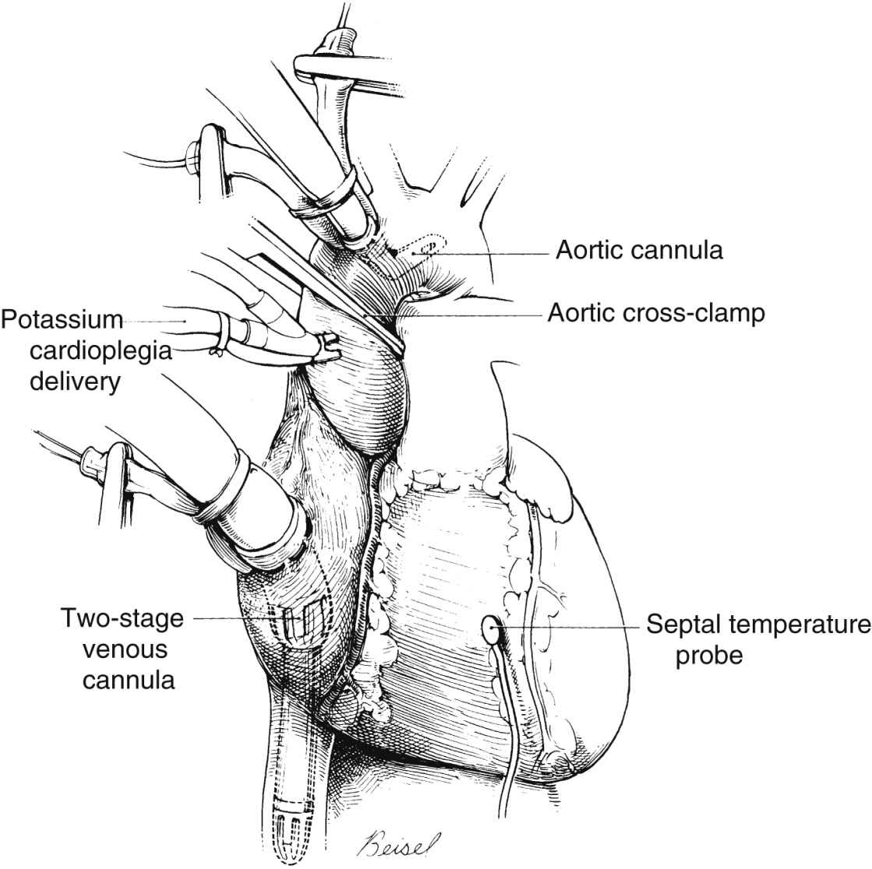
Blood Oxygenators
Blood flow to the oxygenator is collected in a reservoir by means of a _______________ pump from large systemic veins (e.g., vena cava).
Blood is pumped through oxygenator and returned to body via the ascending aorta.
Blood flow rates through the oxygenator can vary between __________ L/min.
A gas mixture of oxygen and carbon dioxide can flow into the oxygenator with rates between _____________L/min.

Slide 4
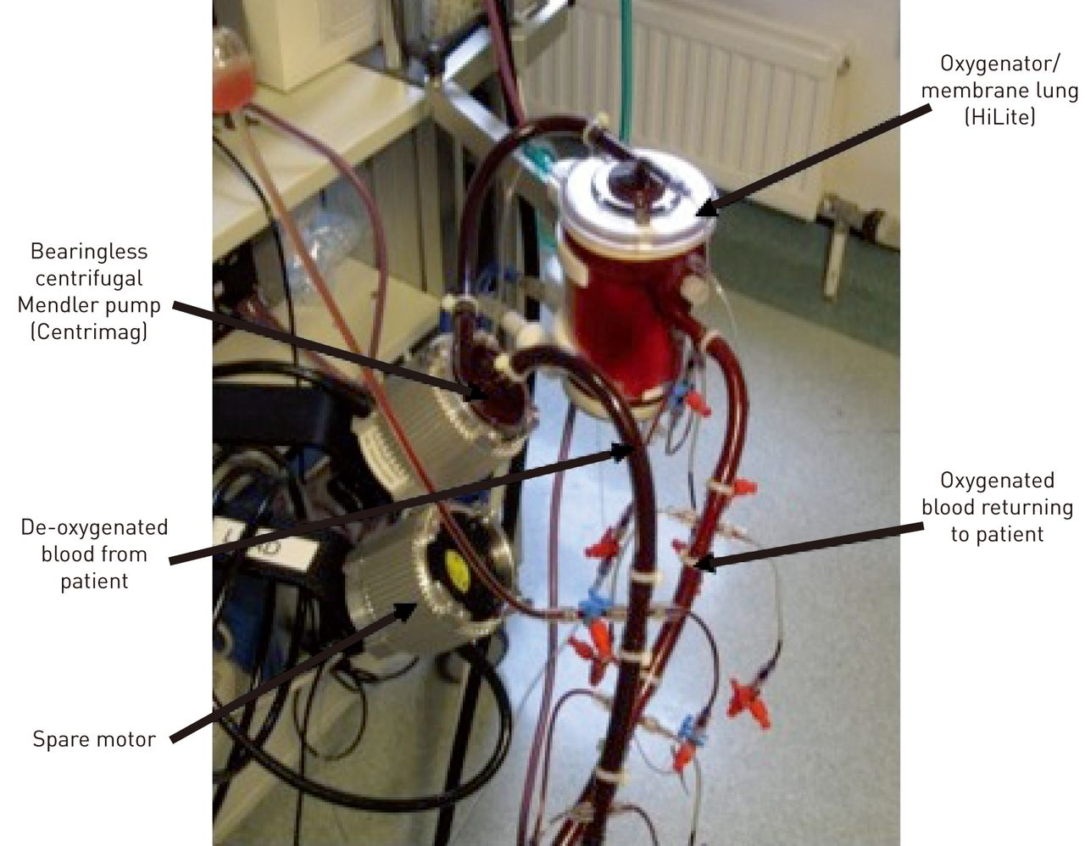
Blood Oxygenators
Normal metabolism requires that the blood be supplied with 250 mL/min of ________, but also remove 200 mL/min of ________.
These rates are based off of body temperature (37ºC) and atmospheric pressure (1 atm = 760 mmHg) (referred to as ______).
__________ is used to prevent clotting within the oxygenator system.
All blood contacting surfaces are coated with anticoagulant formulations to minimize blood clot formation and minimize dosage of systemic heparin.

Slide 5
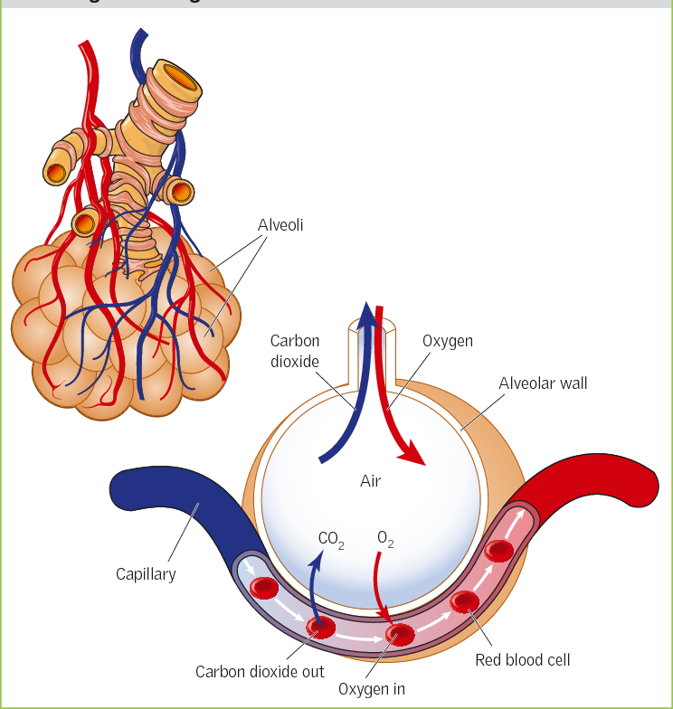
Operating Characteristics of Oxygenators
Blood usually enters lungs or oxygenator with oxygen partial pressure of pO₂ = __________. Blood usually leaves the lungs with an arterial partial pressure of 95 mmHg.
In the lungs, the diffusional distance between the capillaries and the alveoli is a few microns, the contact time is on the scale of tenths of a second, and the total surface area for oxygen transport is about __________.
For blood oxygenators, there is a longer diffusional distance with additional resistances between the blood and gas. The contact time is much longer, on the order of tens of seconds. The surface area can vary but can range between 1-10 m².

Slide 6
Operating Characteristics of Oxygenators
For lungs, the difference between the partial pressures in the alveoli (104 mmHg) and in the capillary is about 40-50 mmHg.
The difference for CO₂ is about -4 mmHg, but CO₂ has a higher permeability through the alveolar wall (roughly 20 times more than O₂).
For oxygenators, the partial pressure of oxygen is about _____________. (1 atm = 760 mmHg; about 47 mmHg is water vapor)
Usually none or low levels of CO₂ are used to improve transfer rates of CO₂.
The large gradients seen in oxygenators allow for less overall area.

Slide 7
Types of Oxygenators
__________ oxygenator
________ oxygenator
gas vent
Thin film blood is formed by means of stationary or moving surface (e.g., rotating disk). Exposed directly to gas. Surface irregularities can be used to promote mixing.
blood
________ oxygenator
gas
blood
Most common used system today. Minimizes trauma to blood. However, film boundary layers provide additional diffusive resistance. But modern membranes have minimize resistances within the membrane itself.
blood
rising gas bubbles
falling film of blood
gas
Earliest form of oxygenators. Can achieve high surface area for transport through introduction of bubbles. However, bubbles contact RBCs inducing mechanical stresses and damaging them. Production of foam can also be very dangerous if not removed before returning to the body.

Slide 8
Types of Membranes
Earliest versions used ___________ with a thickness between 50-200 μm. For a 130 μm-thick membrane, O₂ and CO₂ permeabilities are about 215 and 1100 mL/(min m² atm) STP (STP = standard temperature and pressure: 0ºC and 1 atm).
Recent membranes use hollow hydrophobic microporous _____________ fibers. Because the membranes are hydrophobic, plasma filtration is not a problem. This in turn provides a nearly resistance free path for O₂ and CO₂ across the membrane. Most of the transport resistance occurs on the blood side.
Hollow fibers have outside diameters between 250 and 400 μm with wall thicknesses between 20-50 μm. The porosity of the membranes varies between 40%-60%.

Slide 9
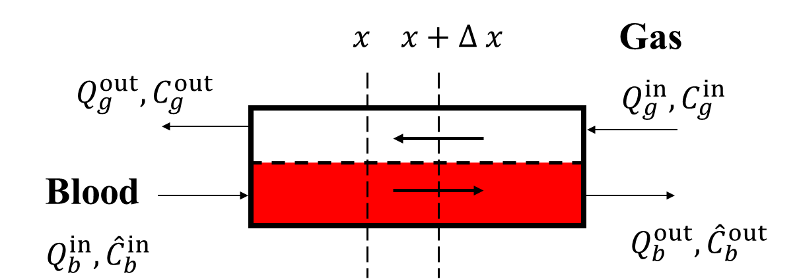

Countercurrent Membrane Oxygenator
We will use the following notation to analyze the countercurrent membrane blood oxygenator. On the blood side, concentration is divided between dissolved gas and saturated hemoglobin, ${\hat{C}}_{b}=C_{b}+C_{b}^{′}$. $C_{bm}$ is concentration on the blood side of the membrane surface, and $C_{gm}$ is concentration on the gas side of the membrane surface.

Slide 10
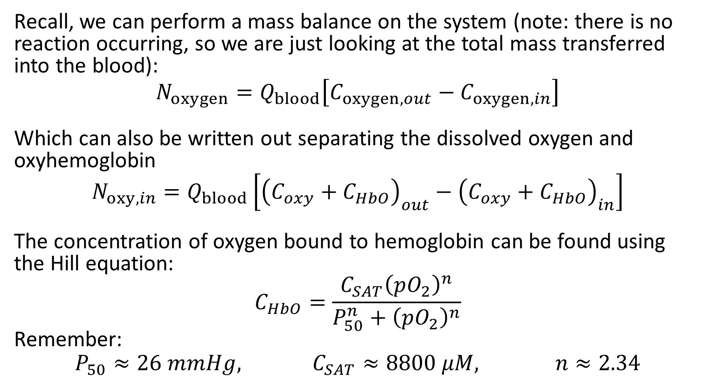
Oxygenator Mass Balance - Review
Recall, we can perform a mass balance on the system (note: there is no reaction occurring, so we are just looking at the total mass transferred into the blood):
$$N_{oxygen}=Q_{blood}\left[C_{oxygen,out}−C_{oxygen,in}\right]$$
Which can also be written out separating the dissolved oxygen and oxyhemoglobin
$$N_{oxy,in}=Q_{blood}\left[{\left(C_{oxy}+C_{HbO}\right)}_{out}−{\left(C_{oxy}+C_{HbO}\right)}_{in}\right]$$
The concentration of oxygen bound to hemoglobin can be found using the Hill equation:
$$C_{HbO}=\frac{C_{SAT}{\left(pO_{2}\right)}^{n}}{P_{50}^{n}+{\left(pO_{2}\right)}^{n}}$$
Remember:
$$P_{50}≈26 mmHg, C_{SAT}≈8800 μM, n≈2.34$$

Slide 11
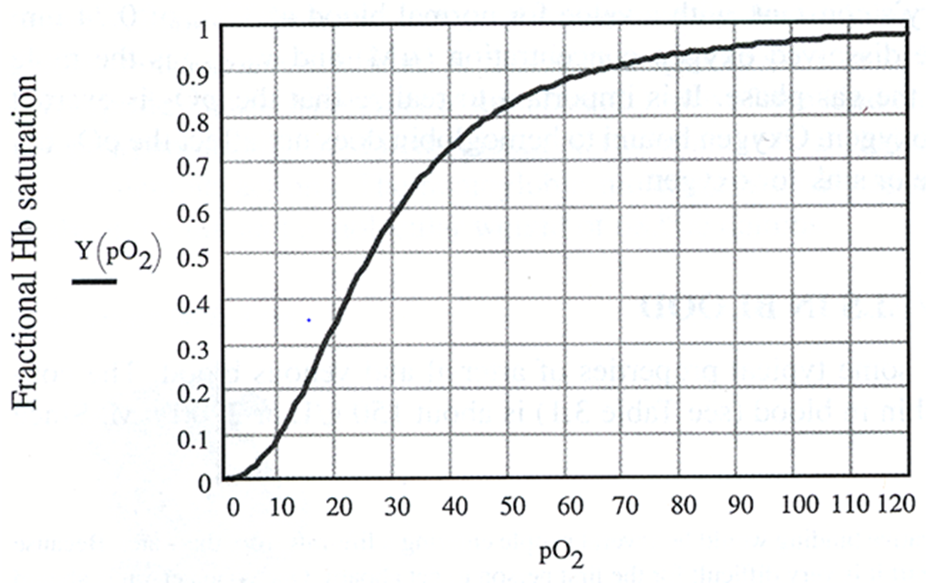
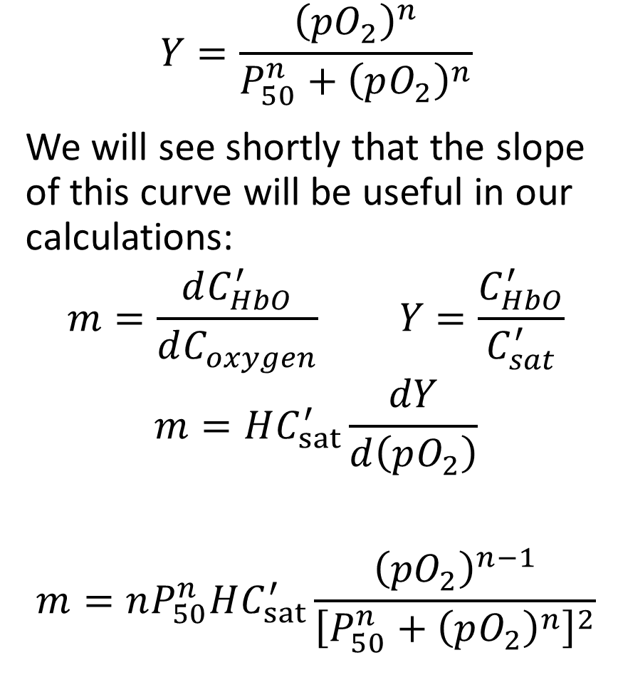
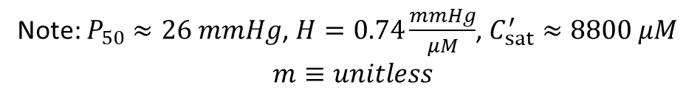
Hill Equation
$$Y=\frac{{\left({pO}_{2}\right)}^{n}}{P_{50}^{n}+{\left(pO_{2}\right)}^{n}}$$
We will see shortly that the slope of this curve will be useful in our calculations:
$$m=\frac{dC_{HbO}^{′}}{dC_{oxygen}} Y=\frac{C_{HbO}^{′}}{C_{sat}^{′}}$$
$$m=HC_{sat}^{′}\frac{dY}{d\left(pO_{2}\right)}$$
$$m=nP_{50}^{n}HC_{sat}^{′}\frac{{\left({pO}_{2}\right)}^{n−1}}{{\left[P_{50}^{n}+{\left(pO_{2}\right)}^{n}\right]}^{2}}$$
Note: $P_{50}≈26 mmHg$, $H=0.74\frac{mmHg}{μM}$, $C_{sat}^{′}≈8800 μM$
$$m≡unitless$$

Slide 12
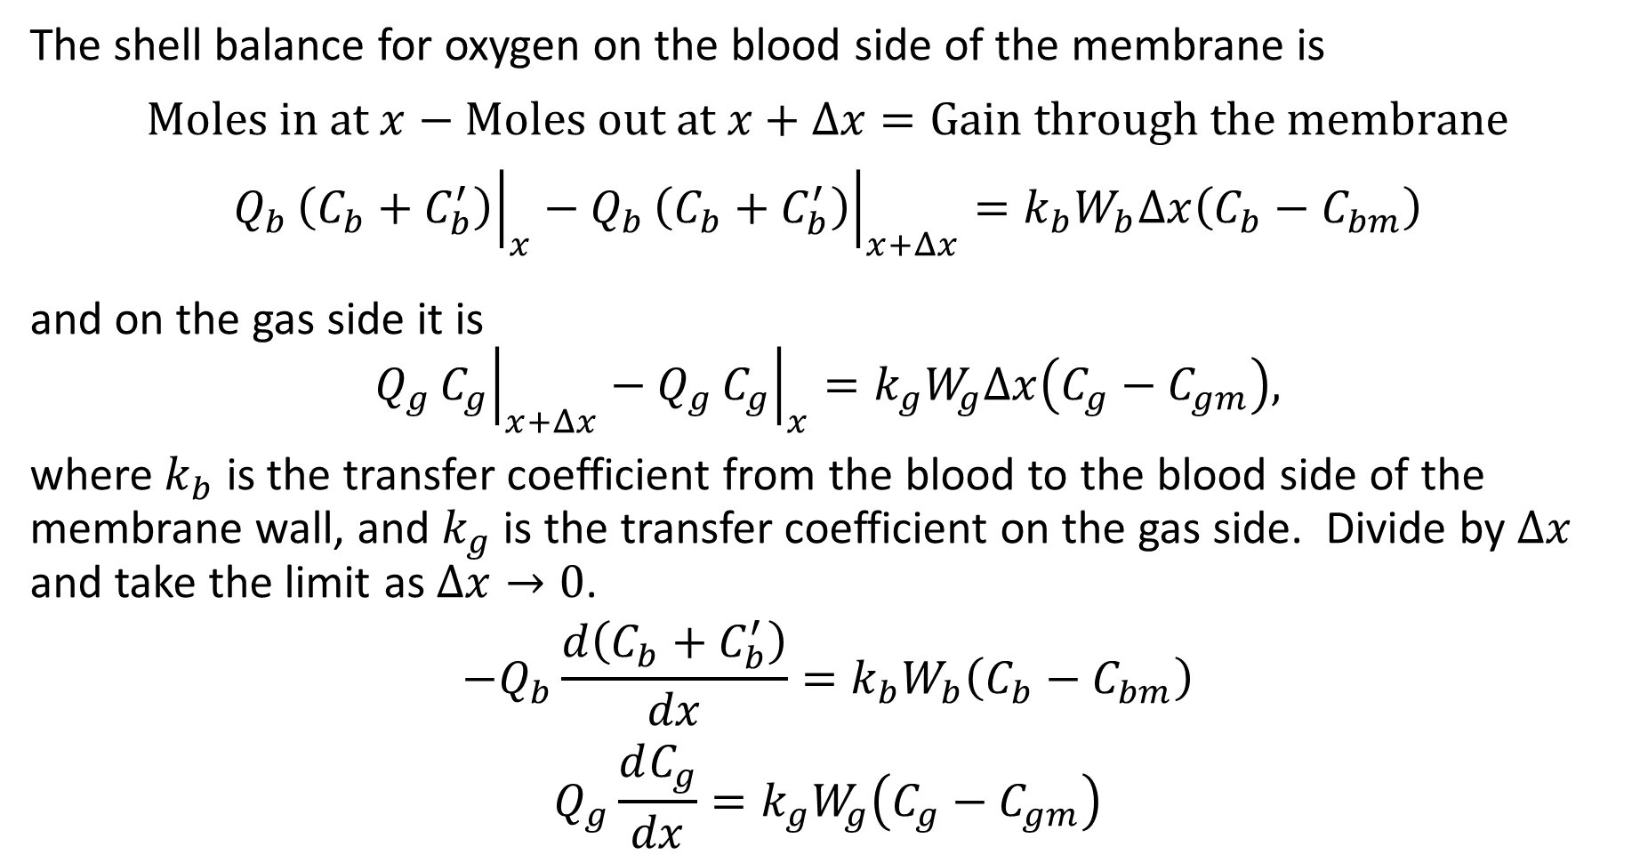
Mass Shell Balance
The shell balance for oxygen on the blood side of the membrane is
$$\text{Moles} \text{in} \text{at} x−\text{Moles} \text{out} \text{at} x+Δx=\text{Gain} \text{through} \text{the} \text{membrane}$$
$$Q_{b}{\left.\left(C_{b}+C_{b}^{′}\right)\right|}_{x}−Q_{b}{\left.\left(C_{b}+C_{b}^{′}\right)\right|}_{x+Δx}=k_{b}W_{b}Δx\left(C_{b}−C_{bm}\right)$$
and on the gas side it is
$$Q_{g}{\left.C_{g}\right|}_{x+Δx}−Q_{g}{\left.C_{g}\right|}_{x}=k_{g}W_{g}Δx\left(C_{g}−C_{gm}\right),$$
where $k_{b}$ is the transfer coefficient from the blood to the blood side of the membrane wall, and $k_{g}$ is the transfer coefficient on the gas side. Divide by $Δx$ and take the limit as $Δx→0$.
$$−Q_{b}\frac{d\left(C_{b}+C_{b}^{′}\right)}{dx}=k_{b}W_{b}\left(C_{b}−C_{bm}\right)$$
$$Q_{g}\frac{dC_{g}}{dx}=k_{g}W_{g}\left(C_{g}−C_{gm}\right)$$

Slide 13
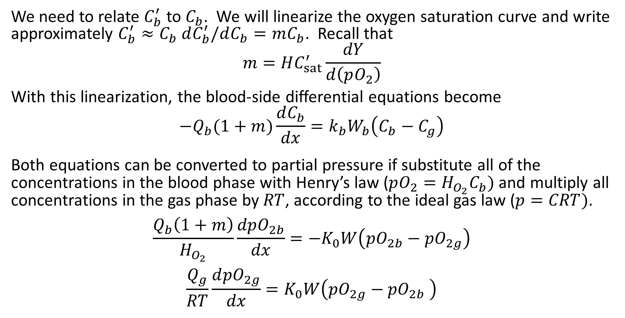
Mass Shell Balance
We need to relate $C_{b}^{′}$ to $C_{b}$. We will linearize the oxygen saturation curve and write approximately $C_{b}^{′}≈C_{b} dC_{b}^{′}/dC_{b}=mC_{b}$. Recall that
$$m=HC_{sat}^{′}\frac{dY}{d\left(pO_{2}\right)}$$
With this linearization, the blood-side differential equations become
$$−Q_{b}(1+m)\frac{dC_{b}}{dx}=k_{b}W_{b}\left(C_{b}−C_{g}\right)$$
Both equations can be converted to partial pressure if substitute all of the concentrations in the blood phase with Henry’s law ($pO_{2}=H_{O_{2}}C_{b})$ and multiply all concentrations in the gas phase by $RT$, according to the ideal gas law ($p=CRT)$.
$$\frac{Q_{b}\left(1+m\right)}{H_{O_{2}}}\frac{dpO_{2b}}{dx}=−K_{0}W\left({pO}_{2b}−{pO}_{2g}\right)$$
$$\frac{Q_{g}}{RT}\frac{d{pO}_{2g}}{dx}=K_{0}W\left({pO}_{2g}−{pO}_{2b} \right)$$

Slide 14
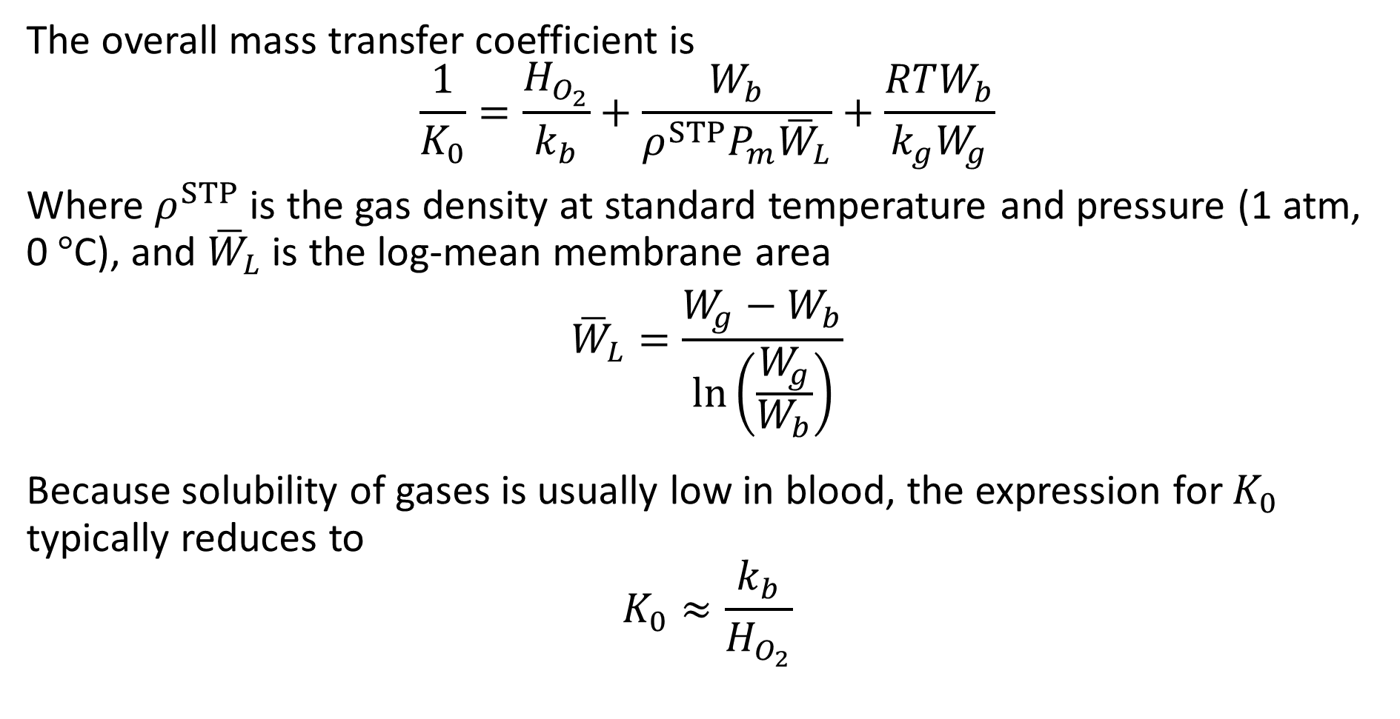
O₂ Mass Transfer
The overall mass transfer coefficient is
$$\frac{1}{K_{0}}=\frac{H_{O_{2}}}{k_{b}}+\frac{W_{b}}{ρ^{STP}P_{m}{\overline{W}}_{L}}+\frac{RTW_{b}}{k_{g}W_{g}}$$
Where $ρ^{STP}$ is the gas density at standard temperature and pressure (1 atm, 0$°$C), and ${\overline{W}}_{L}$ is the log-mean membrane area
$${\overline{W}}_{L}=\frac{W_{g}−W_{b}}{\ln\left(\frac{W_{g}}{W_{b}}\right)}$$
Because solubility of gases is usually low in blood, the expression for $K_{0}$ typically reduces to
$$K_{0}≈\frac{k_{b}}{H_{O_{2}}}$$

Slide 15
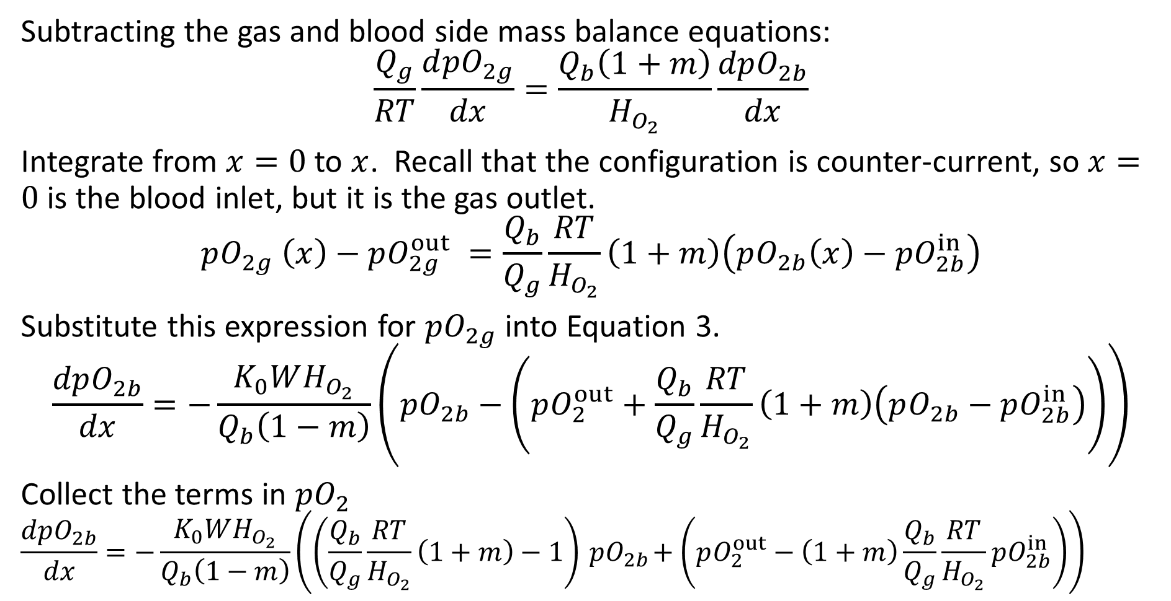
O₂ Mass Transfer
Subtracting the gas and blood side mass balance equations:
$$\frac{Q_{g}}{RT}\frac{d{pO}_{2g}}{dx}=\frac{Q_{b}\left(1+m\right)}{H_{O_{2}}}\frac{dpO_{2b}}{dx}$$
Integrate from $x=0$ to $x$. Recall that the configuration is counter-current, so $x=0$ is the blood inlet, but it is the gas outlet.
$$pO_{2g} \left(x\right)−pO_{2g}^{out} =\frac{Q_{b}}{Q_{g}}\frac{RT}{H_{O_{2}}}\left(1+m\right)\left(pO_{2b}\left(x\right)−pO_{2b}^{in}\right)$$
Substitute this expression for $pO_{2g}$ into Equation 3.
$$\frac{dpO_{2b}}{dx}=−\frac{K_{0}WH_{O_{2}}}{Q_{b}\left(1−m\right)}\left({pO}_{2b}−\left(pO_{2}^{out}+\frac{Q_{b}}{Q_{g}}\frac{RT}{H_{O_{2}}}\left(1+m\right)\left(pO_{2b}−pO_{2b}^{in}\right)\right)\right)$$
Collect the terms in $pO_{2}$
$$\frac{dpO_{2b}}{dx}=−\frac{K_{0}WH_{O_{2}}}{Q_{b}\left(1−m\right)}\left(\left(\frac{Q_{b}}{Q_{g}}\frac{RT}{H_{O_{2}}}\left(1+m\right)−1\right){ pO}_{2b}+\left(pO_{2}^{out}−\left(1+m\right)\frac{Q_{b}}{Q_{g}}\frac{RT}{H_{O_{2}}}pO_{2b}^{in}\right)\right)$$

Slide 16
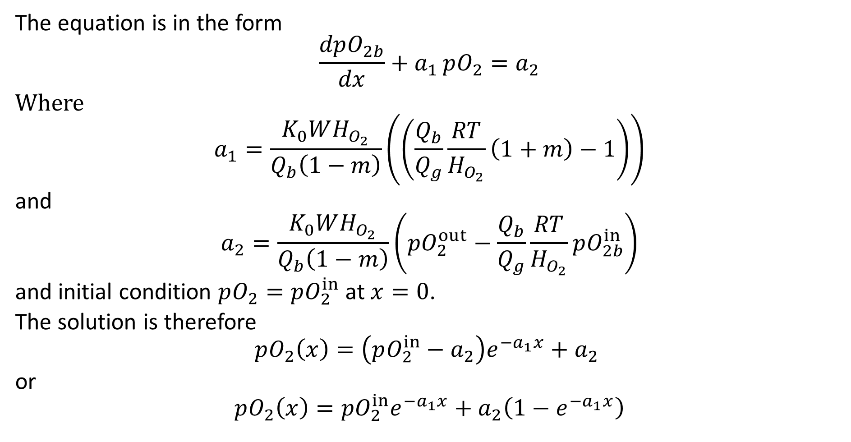
O₂ Mass Transfer
The equation is in the form
$$\frac{dpO_{2b}}{dx}+a_{1} pO_{2}=a_{2}$$
Where
$$a_{1}=\frac{K_{0}WH_{O_{2}}}{Q_{b}\left(1−m\right)}\left(\left(\frac{Q_{b}}{Q_{g}}\frac{RT}{H_{O_{2}}}\left(1+m\right)−1\right)\right)$$
and
$$a_{2}=\frac{K_{0}WH_{O_{2}}}{Q_{b}\left(1−m\right)}\left(pO_{2}^{out}−\frac{Q_{b}}{Q_{g}}\frac{RT}{H_{O_{2}}}pO_{2b}^{in}\right)$$
and initial condition $pO_{2}=pO_{2}^{in}$ at $x=0$.
The solution is therefore
$$pO_{2}\left(x\right)=\left(pO_{2}^{in}−a_{2}\right)e^{{−a}_{1}x}+a_{2}$$
or
$$pO_{2}\left(x\right)=pO_{2}^{in}e^{−a_{1}x}+a_{2}\left(1−e^{−a_{1}x}\right)$$

Slide 17
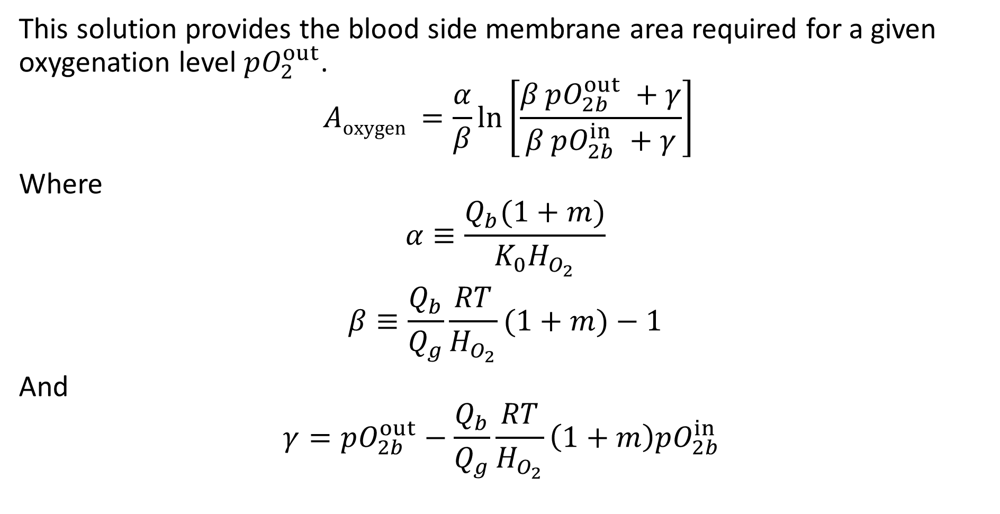
O₂ Mass Transfer – required membrane area
This solution provides the blood side membrane area required for a given oxygenation level $pO_{2}^{out}$.
$$Aoxygen =\frac{α}{β}\ln\left[\frac{β pO_{2b}^{out} +γ}{β pO_{2b}^{in} +γ}\right]$$
Where
$$α≡\frac{Q_{b}(1+m)}{K_{0}H_{O_{2}}}$$
$$β≡\frac{Q_{b}}{Q_{g}}\frac{RT}{H_{O_{2}}}(1+m)−1$$
And
$$γ=pO_{2b}^{out}−\frac{Q_{b}}{Q_{g}}\frac{RT}{H_{O_{2}}}\left(1+m\right)pO_{2b}^{in}$$

Slide 18
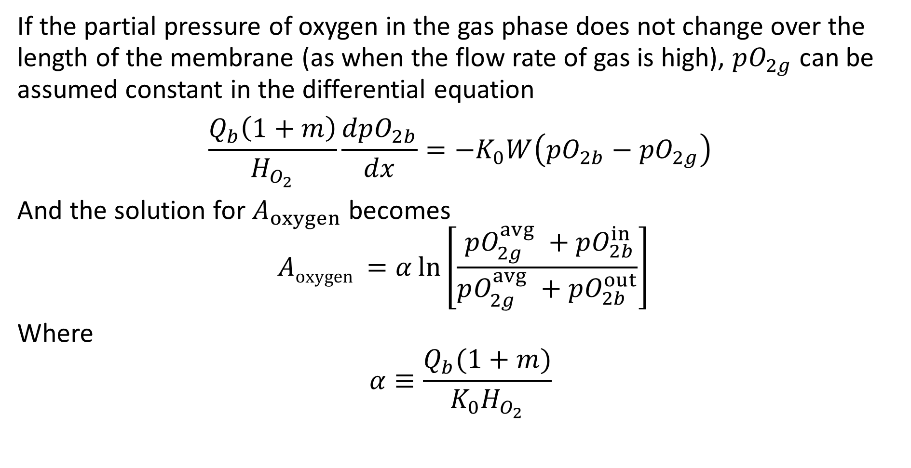
Constant Gas O₂ Partial Pressure
If the partial pressure of oxygen in the gas phase does not change over the length of the membrane (as when the flow rate of gas is high), $pO_{2g}$ can be assumed constant in the differential equation
$$\frac{Q_{b}\left(1+m\right)}{H_{O_{2}}}\frac{dpO_{2b}}{dx}=−K_{0}W\left({pO}_{2b}−{pO}_{2g}\right)$$
And the solution for $A_{oxygen}$ becomes
$$Aoxygen =α\ln\left[\frac{ pO_{2g}^{avg} +pO_{2b}^{in}}{pO_{2g}^{avg} +pO_{2b}^{out}}\right]$$
Where
$$α≡\frac{Q_{b}(1+m)}{K_{0}H_{O_{2}}}$$

Slide 19
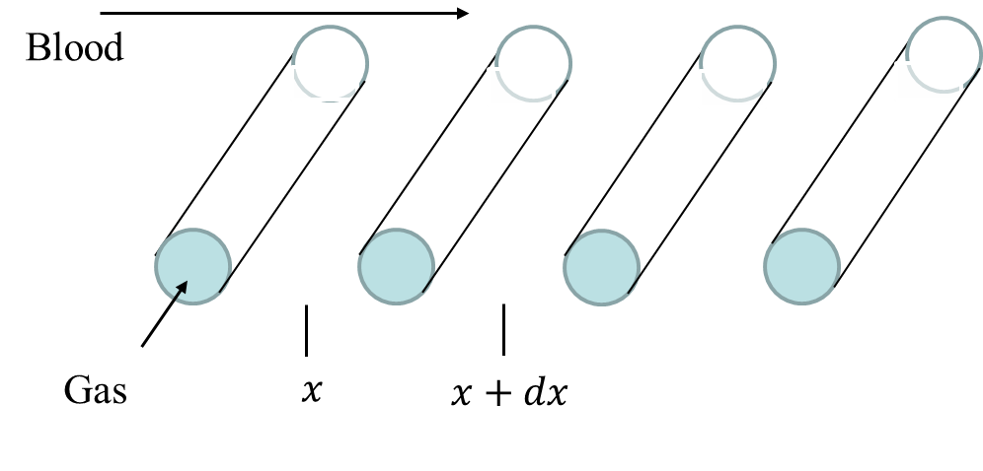

Cross Flow Oxygenator
Let the blood flow over a set of hollow fibers with flowing oxygen at partial pressure $pO_{2g}$. Assume that the flow rate in the hollow fibers is high enough that $pO_{2g}$ does not change along the fibers.
Assume that the spacing between fibers is small enough that it can be approximated as the differential, $dx$.

Slide 20
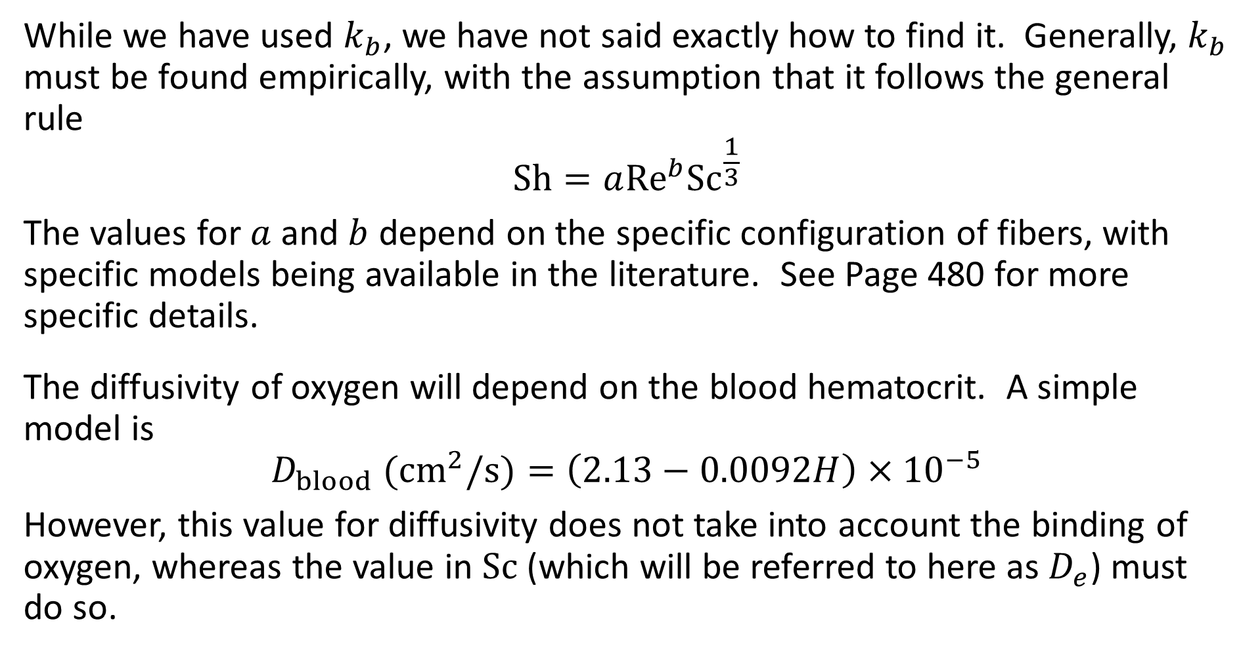
Mass Transfer Coefficient
While we have used $k_{b}$, we have not said exactly how to find it. Generally, $k_{b}$ must be found empirically, with the assumption that it follows the general rule
$$\text{Sh}=a{\text{Re}}^{b}{\text{Sc}}^{\frac{1}{3}}$$
The values for $a$ and $b$ depend on the specific configuration of fibers, with specific models being available in the literature. See Page 480 for more specific details.
The diffusivity of oxygen will depend on the blood hematocrit. A simple model is
$$D_{blood} \text{(}{\text{cm}}^{2}\text{/}\text{s}\text{)}=\left(2.13−0.0092H\right)×{10}^{−5}$$
However, this value for diffusivity does not take into account the binding of oxygen, whereas the value in $\text{Sc}$ (which will be referred to here as $D_{e}$) must do so.

Slide 21
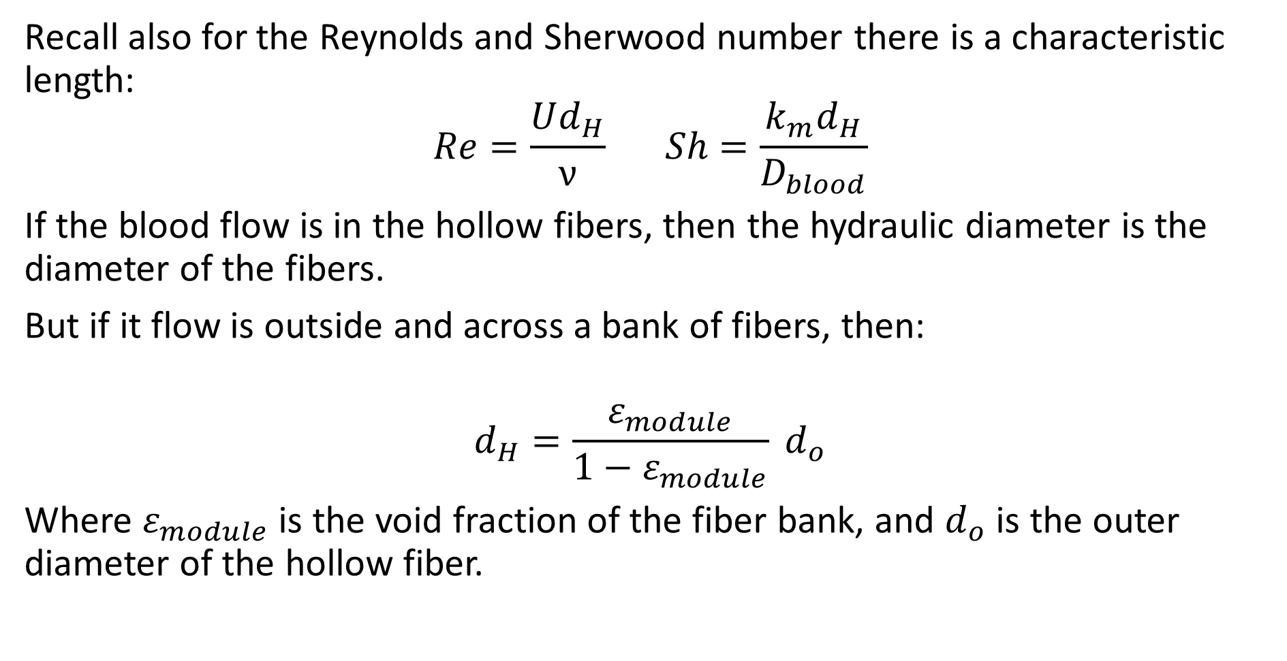
Mass Transfer Coefficient
Recall also for the Reynolds and Sherwood number there is a characteristic length:
$$Re=\frac{Ud_{H}}{ν} Sh=\frac{k_{m}d_{H}}{D_{blood}}$$
If the blood flow is in the hollow fibers, then the hydraulic diameter is the diameter of the fibers.
But if it flow is outside and across a bank of fibers, then:
$$d_{H}=\frac{ε_{module}}{1−ε_{module}} d_{o}$$
Where $ε_{module}$ is the void fraction of the fiber bank, and $d_{o}$ is the outer diameter of the hollow fiber.

Slide 22
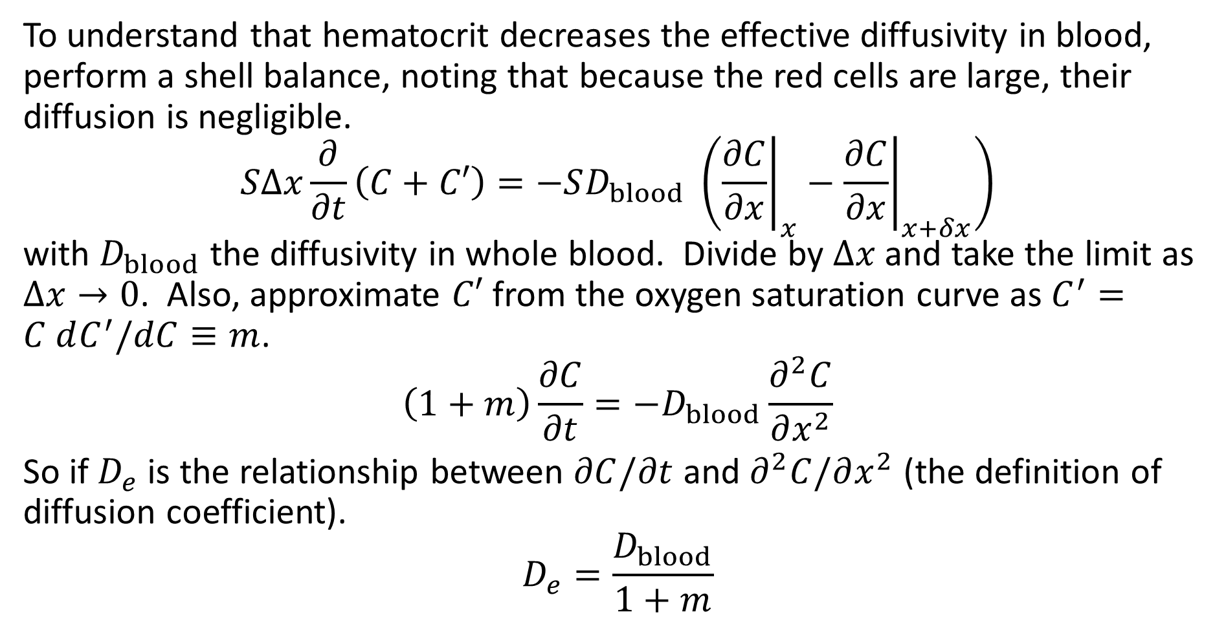
Diffusivity in Whole Blood
To understand that hematocrit decreases the effective diffusivity in blood, perform a shell balance, noting that because the red cells are large, their diffusion is negligible.
$$SΔx\frac{∂}{∂t}\left(C+C′\right)=−SD_{blood} \left({\left.\frac{∂C}{∂x}\right|}_{x}−{\left.\frac{∂C}{∂x}\right|}_{x+δx}\right)$$
with $D_{blood}$ the diffusivity in whole blood. Divide by $Δx$ and take the limit as $Δx→0$. Also, approximate $C′$ from the oxygen saturation curve as $C^{′}=C dC^{′}/dC≡m$.
$$\left(1+m\right)\frac{∂C}{∂t}=−D_{blood}\frac{∂^{2}C}{∂x^{2}}$$
So if $D_{e}$ is the relationship between $∂C/∂t$ and $∂^{2}C/∂x^{2}$ (the definition of diffusion coefficient).
$$D_{e}=\frac{D_{blood}}{1+m}$$

Slide 23
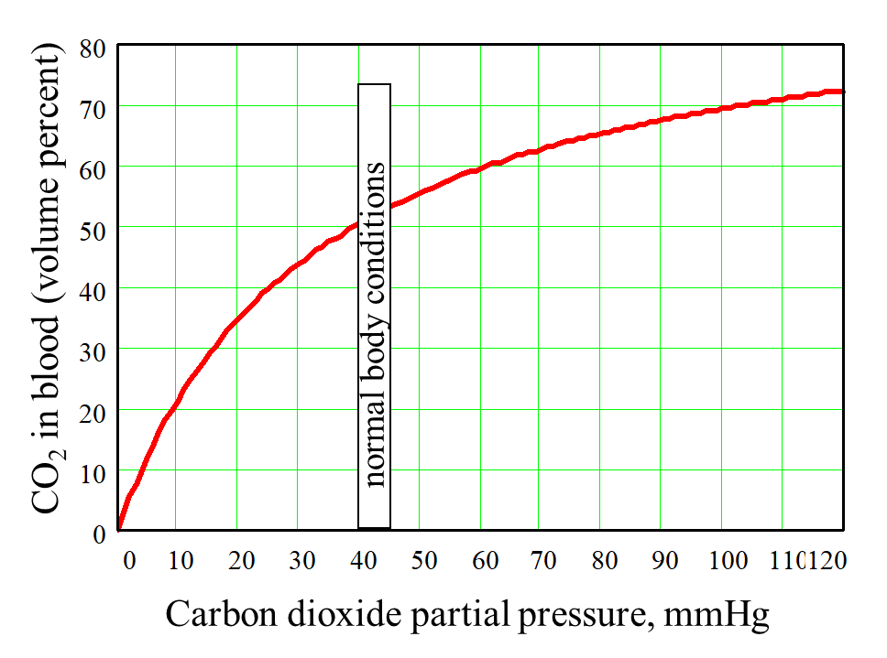
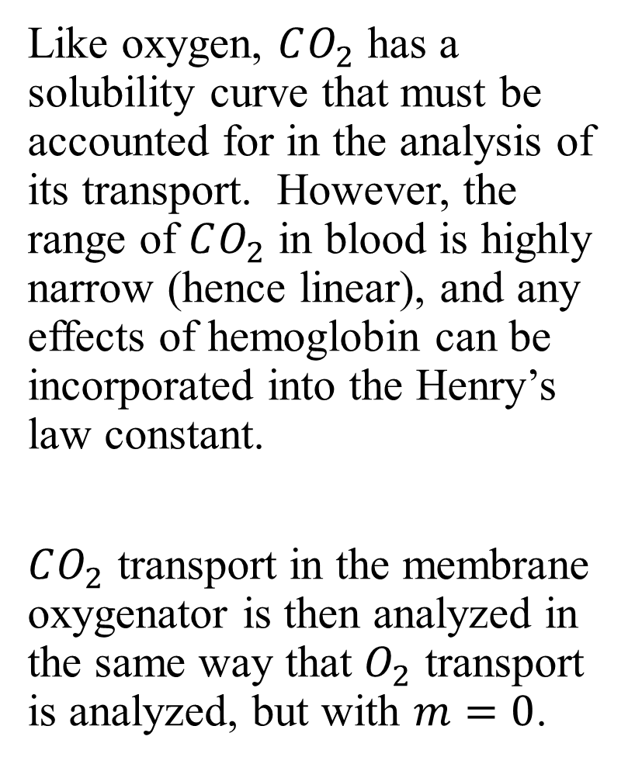
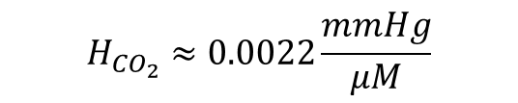
CO₂ Transfer
Like oxygen, $CO_{2}$ has a solubility curve that must be accounted for in the analysis of its transport. However, the range of $CO_{2}$ in blood is highly narrow (hence linear), and any effects of hemoglobin can be incorporated into the Henry’s law constant.
$CO_{2}$ transport in the membrane oxygenator is then analyzed in the same way that $O_{2}$ transport is analyzed, but with $m=0$.
$$H_{CO_{2}}≈0.0022\frac{mmHg}{μM}$$

